Slide 1
COMMUNICATION and social skills
Ms. Aqsa Fayyaz
Science and Humanities Department
FAST NUCES Karachi

Slide 2
Learning outcomes
Students will be able to understand and apply knowledge of human communication and language processes as they occur.
Students would learn what social skills are and how these can be applied to build a healthy connection with people around them.

Slide 3
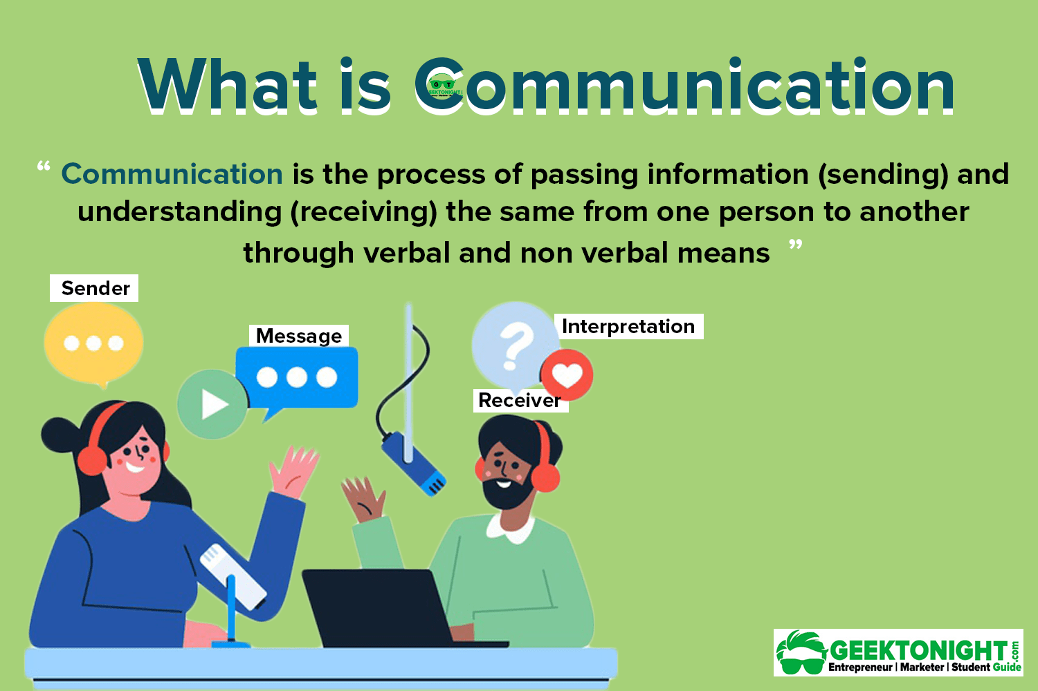

Slide 4
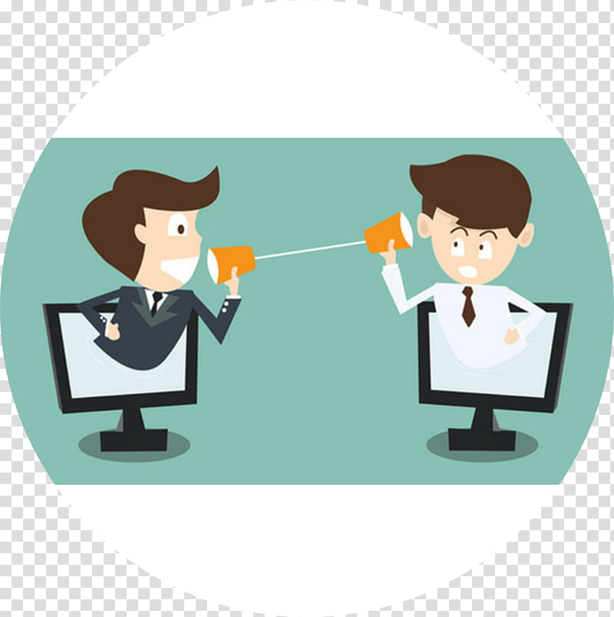
Communication process
Sender
Message
Encoding
Channel
Receiver
Decoding
Feedback
For example, in a conversation, which is the most common type of communication, the person who speaks is the source and the person who listens is the audience.
What is transmitted by the person who speaks is the message and the spoken voice carried through the air is the channel.

Slide 5
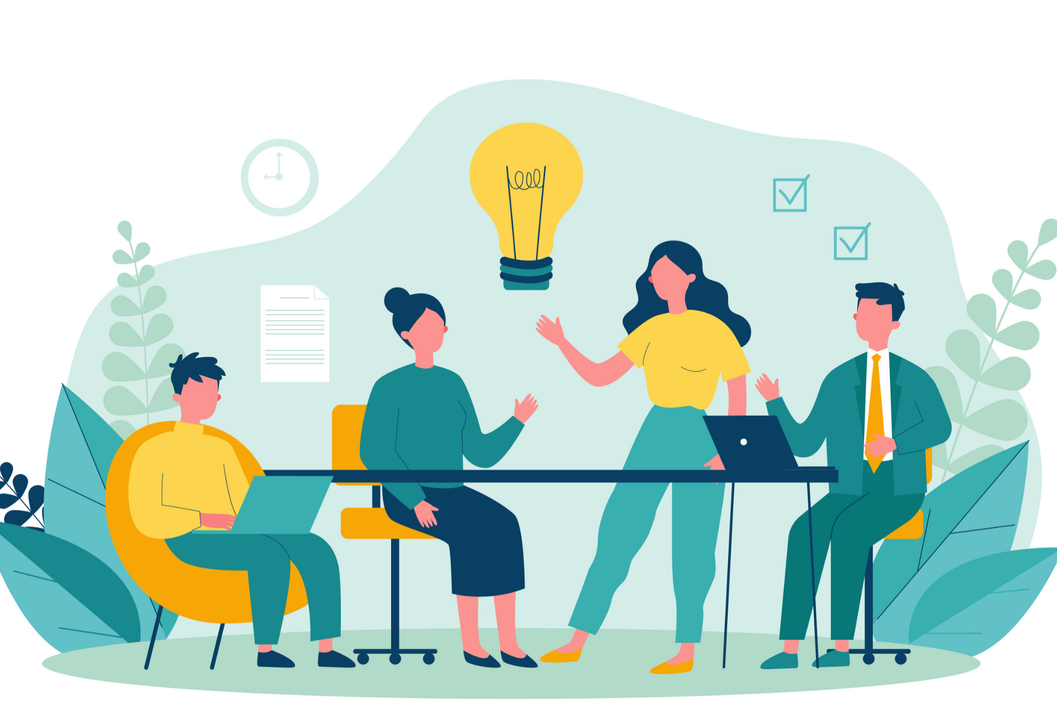
Functions of Communication
These are the following functions of communication:
Informing
Persuading
Integrating
Creating Relationships
Help in Making Selections between Alternatives
Reducing Misunderstandings
Making Decisions

Slide 6
1. Information Function
Informing messages to others is regarded as the principal function of communication. It is done verbally or non-verbally. Verbal messages can be oral or written. Whereas, non-verbal messages are conveyed through the use of body language, gestures, postures and so forth.
2. Persuading
Persuading is referred to making someone do or believe something, by giving them a valid and genuine reason to do it. .
3. Making Decisions:
The individuals, who are in leadership positions are assigned with the authority to make decisions. When they need to make decisions, which prove to be meaningful and advantageous to organizations, on the whole, they need to seek ideas and suggestions from others as well.

Slide 7
3. integrating:
It is comprehensively understood that individuals cannot work in isolation. In order to carry out one’s job duties in a well-organized manner and achieve the desired goals and objectives, the individuals need to work in integration with each other. When they work in integration, they are able to benefit in a number of ways.
Example: Team work
4. Creating Relationships and reducing misunderstandings
Effective communication is regarded as the foundation for the creation of relationships and reducing misunderstandings.
When the individuals will communicate with each other in a respectful and polite manner, they will be able to render a significant contribution in creating relationships.

Slide 8
types of communication
Verbal Communication: Verbal communication refers to the form of communication in which message is transmitted verbally; communication is done by word of mouth and writing.
1. Oral communication /Spoken: Spoken words are used. It includes face-to-face conversations, speech, telephonic conversation, video, radio, television, voice over internet
2.Written communication: Written signs or symbols are used to communicate through letter, report, memo, reports, bulletins, job descriptions, employee manuals, and electronic mail etc.
Non-Verbal Communication
facial expressions, body movements, and gestures, appearance.

Slide 9
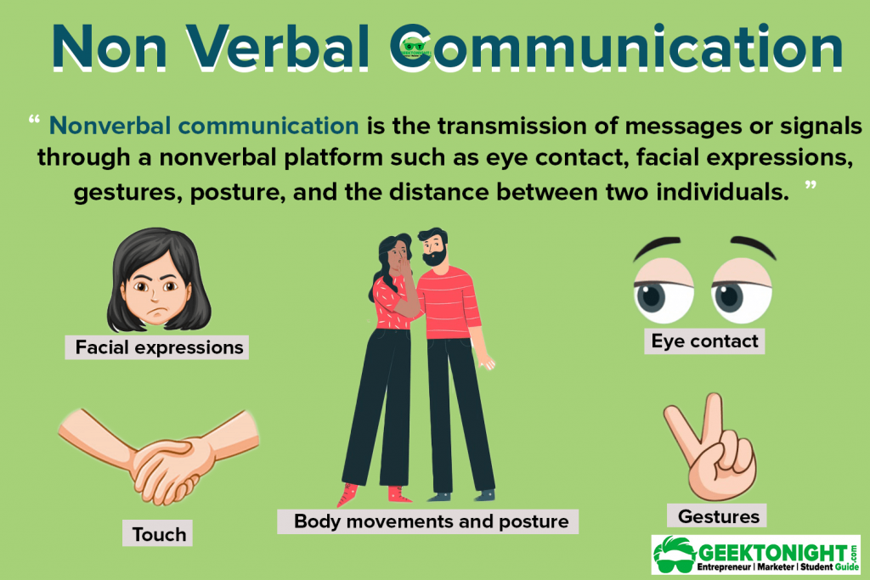

Slide 10
7 C’s of communication
It is a list of principles for written and spoken communication to ensure the communication is effective.
Completeness:
The message will have all the information the reader needs to know to be able to respond or take action. Gives additional information wherever required. Leaves no questions in the mind of the receiver.
2. Conciseness:
Conciseness means communicating what you want to express in least possible words. It provides short and necessary message in limited words.
Non-repetitive in nature & Saves time.
3. Coherent : Your message needs to have a logical flow. All sentences in your message should be connected to the previous one and stick to the main topic.

Slide 11
4. Clarity
Clarity implies stressing on a particular message or goal at a time, rather than trying to achieve too much at once.
Complete clarity of thoughts and ideas heightens the meaning of a message.
5. Concreteness
Concrete communication means being particular and clear rather than fuzzy and general.
6. Courtesy
Courteous message is positive and focused on the audience. It makes use of terms expressing respect for the receiver of a message.
7. Correctness
Correctness in communication means that there are no grammatical errors in communication.
Checks for the preciseness and accuracy of facts and figures used in the message.
It makes use of appropriate and correct language in the message.

Slide 13
1. Passive communication
Developed a pattern of avoiding expressing their opinions or feelings, protecting their rights, and identifying and meeting their needs.
Do not respond clearly to hurtful or anger-inducing situations.
Used as a “door mat” by other people.
Person is not willing to stand up for his or her position
Wants to avoid conflict at all costs
Allow others to violate their rights Is acceptable when the issue is not important.
Nonverbal cues—no eye contact, low pitch to voice

Slide 14
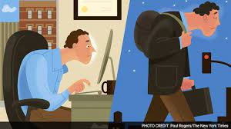
Passive communicators will often:
Fail to assert for themselves
Exhibit poor eye contact and slumped body posture
Fail to express their feelings, needs, or opinions
Tend to speak softly or apologetically
Allow others to deliberately or inadvertently infringe on their rights

Slide 15
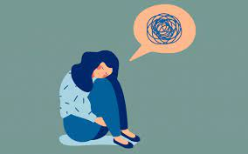
The impact of passive communication ON (Feelings)
often feel anxious because life seems out of their control
often feel confused because they ignore their own feelings
often feel depressed because they feel stuck and hopeless
often feel resentful (but are unaware of it) because their needs are not being met

Slide 16
A passive communicator will say, believe, or behave like:
“I’m unable to stand up for my rights.”
“I don’t know what my rights are.”
“I get stepped on by everyone."
“I’m weak and unable to take care of myself.”
“People never consider my feelings.”

Slide 17
Case example
You are approached by a coworker who asks you to finish a project she has started.
She needs to leave early to get ready for a friend's birthday party.
You realize that the project can't possibly get finished by the time you usually leave work and you have already made plans to meet an old friend for dinner.
Possible responses
Passive: “Sure, I'll finish it for you.”
Consequences: You ignore your own needs to satisfy someone else's needs. You stay late, miss your dinner date, and feel frustrated, annoyed, and victimized

Slide 18
2. Aggressive style
The Hammer ( through their communication style, they are likely to hurt others)
Stands up for his or her rights but violates those of others
Creates win/lose situation
“My way or the highway.” Either you do what they are saying or there will be no discussion.
Nonverbal cues—pointing fingers, glaring, crossing arms, hands on hips, speaking loudly.
Due to this communicating style, people eventually start to avoid and hate them.

Slide 19
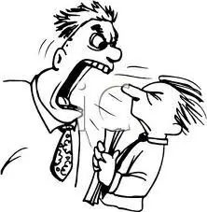
Aggressive communicators will often:
Try to dominate others by humiliation
Criticize, blame, or attack others
Be very impulsive (Acts without thinking)
Have low frustration tolerance
Speak in a loud, demanding, and overbearing voice
Act threateningly and rudely
Not listen well , Interrupts frequently
Use “you” statements

Slide 20
The aggressive communicator will say, believe, or behave like:
“I’m superior and right and you’re inferior and wrong.”
“I’m loud, bossy and pushy.”
“I can dominate and intimidate you.”
“I can violate your rights.”
“I’ll get my way no matter what.”
“You’re not worth anything.”
“It’s all your fault.”
“I react instantly.”
“I’m entitled.”

Slide 21
Case:
You are approached by a coworker who asks you to finish a project she has started.
She needs to leave early to get ready for a friend's birthday party.
You realize that the project can't possibly get finished by the time you usually leave work and you have already made plans to meet an old friend for dinner.
Aggressive: “Why should I help you out? I have my own plans for the evening.” And you walk away.
Consequences: You get your needs met, but you do it by being a bully. The other person leaves feeling uncomfortable, angry, or embarrassed, and you've certainly damaged the relationship

Slide 22
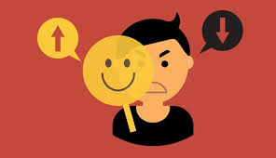
3.PASSIVE-AGGRESSIVE COMMUNICATION
Is a style in which individuals appear passive on the surface but are really acting out anger in a subtle, indirect, or behind-the-scenes way.
People who develop a pattern of passive-aggressive communication usually feel powerless, stuck, and resentful – in other words, they feel incapable of dealing directly with the object of their resentments.

Slide 23
Passive-Aggressive communicators will often
Mumble to themselves rather than confront the person or issue.
have difficulty acknowledging their anger
use facial expressions that don't match how they feel - i.e., smiling when angry
use sarcasm
deny there is a problem
appear cooperative while purposely doing things to annoy and disrupt

Slide 24
The PASSIVE aggressive communicator will say, believe or behave like:
“I’m weak and resentful, so I sabotage, frustrate, and disrupt.”
“I will appear cooperative but I’m not.
The impact of this communication style
They become isolated from those around them
Remain stuck in a position of powerlessness
Discharge resentment while real issues are never addressed

Slide 25
Case
Passive-Aggressive: “Sure, I'll finish it for you.” And you work on her project until 5:00 p.m. and then leave to meet your friend. Your coworker's project isn't finished, but then that's not your problem. You'll just explain to her tomorrow that you did all you possibly could. She could get into trouble, but she certainly can't blame you.
Consequences: You're acting like a wolf in sheep's clothing. You appear to be helpful but you're not helping your coworker at all. This interaction certainly won't contribute to a trusting relationship with your coworker

Slide 26
4. ASSERTIVE COMMUNICATION
It’s a style in which individuals clearly state their opinions and feelings, and firmly advocate for their rights and needs without violating the rights of others.
Creates win/win situations
Balance everyone's needs
These individuals value themselves, their time, and their emotional, spiritual, and physical needs and are strong advocates for themselves while being very respectful of the rights of others.

Slide 27
Assertive communicators will:
state needs and wants clearly, appropriately, and respectfully
use “I” statements
communicate respect for others , listen well without interrupting
have good eye contact , speak in a calm and clear tone of voice
have a relaxed body posture
feel competent and in control , not allow others to abuse or manipulate them
stand up for their rights

Slide 28
The assertive communicator will say, believe, or behave in a way that says
“We are equally entitled to express ourselves respectfully to one another.
“I can’t control others but I can control myself.”
“I realize I have choices in my life and I consider my options.”
The impact of this communication on these individuals:
feel connected to others
They address issues and problems as they arise
create a respectful environment for others to grow and mature

Slide 29
Case.
You are approached by a coworker who asks you to finish a project she has started. She needs to leave early to get ready for a friend's birthday party. You realize that the project can't possibly get finished by the time you usually leave work and you have already made plans to meet an old friend for dinner.
Assertive: “I'm sorry but I can't help you tonight. I have dinner plans. Perhaps you might ask (name of other coworker) to see if he (or she) can help you out.”
Consequences: You have shown respect for the coworker's needs while protecting your own

Slide 30
Think about problems “YOU” may have experienced when working in groups
ACTIVITY

Slide 31
What are social skills?
Social skills are commonly defined as those specific behavioral strategies that allow one to:
Initiate and maintain positive interactions with others.
Develop friendships and support networks.
Cope effectively with the environment
These are the learned abilities that enable an individual to interact appropriately in a given social context., also referred to as “interpersonal” or “soft skills.

Slide 32
Many different skills fall under the umbrella of social skills, including:
Understanding social rules
Understanding and using correct body language
Using appropriate words/ language
Using empathy to understand the world from someone else’s point of view
Understanding and using appropriate tone of voice and volume when communicating
EXAMPLES OF SOME SOCIAL SKILLS: Empathy, active listening, leadership skills etc

Slide 33
BUT Why social skills are important?
Help you to communicate your needs and wants clearly and effectively
Help to build and maintain successful relationships professionally and personally.
Navigate tricky social situations
Be considered for career opportunities
AREAS IN STUDENTS LIFE WHERE THESE SKILLS ARE REQUIRED:
Parents related
Teachers related
Peers related

Slide 34
Consequences of Poor Social Skills in Students
Experience difficulties in interpersonal relationships with parents, teachers, and peers.
Which produce negative responses from others that lead to high levels of peer rejection.
Peer rejection has been linked on several occasions with school violence. Mental health problems like anxiety, depression and a lot of aggression.
Poor academic performance as an indirect consequence.
Show a higher incidence of involvement in the criminal justice system as adults.

Slide 35
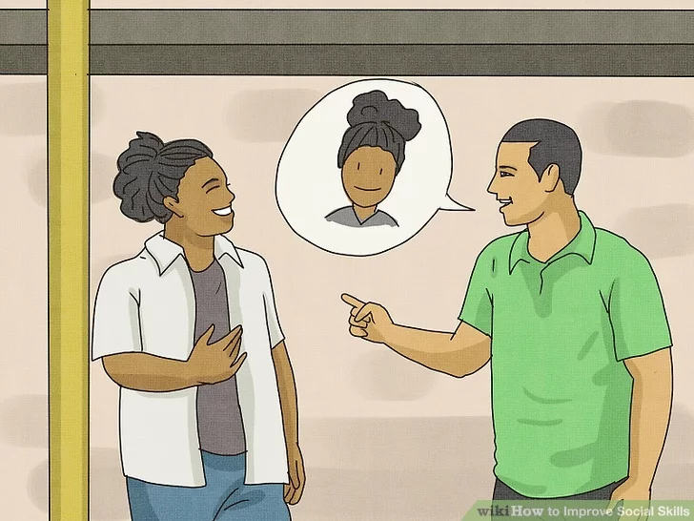
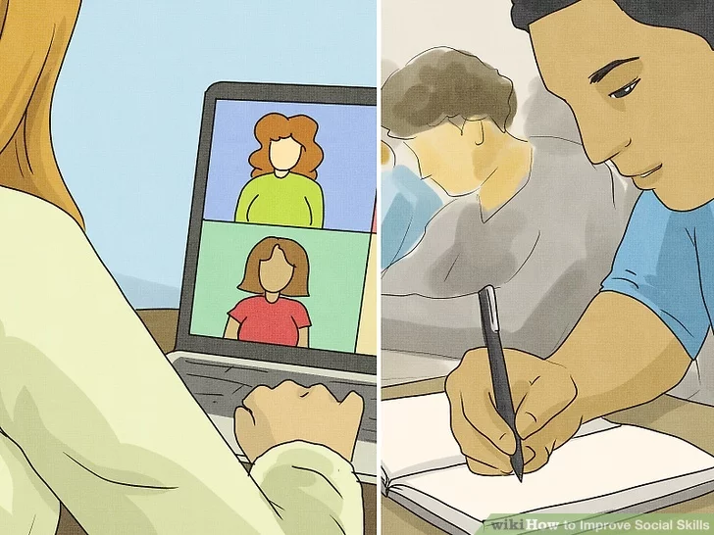
How to improve social skills:
Compliment someone: Compliments are a great way to break the ice with a stranger.
Eg: You could say "I love your coat" or "I really like the way you style your hair."
2. Join a class or club: Clubs, classes, and teams are great ways to meet like-minded people.
Eg: You might say, "It’s so nice to see so many people here" or "What brings you here?

Slide 36
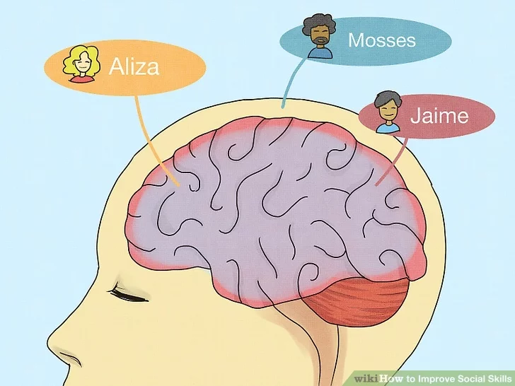
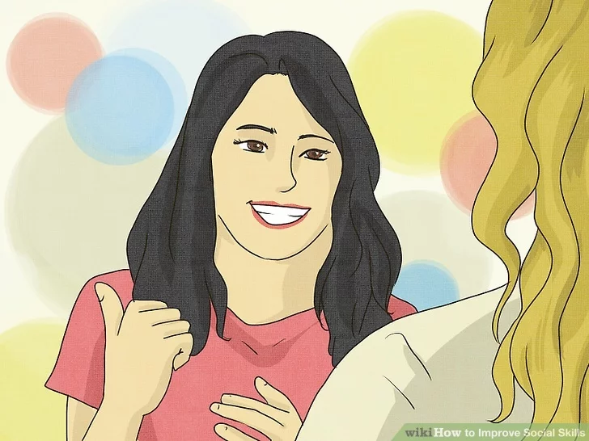
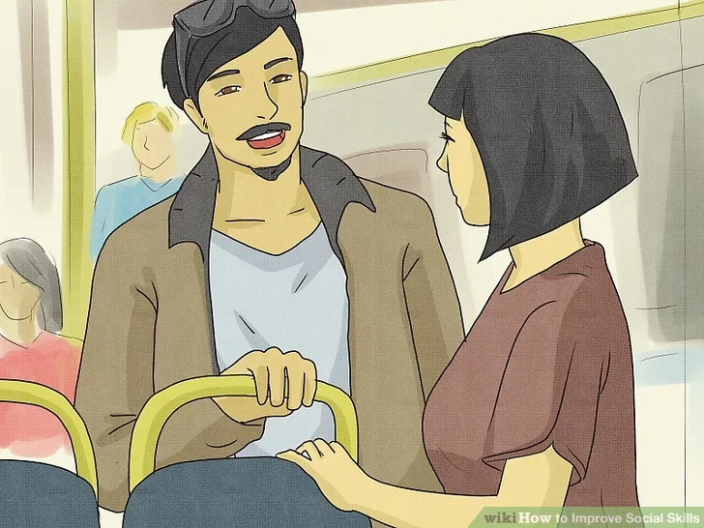
3. Commit names to memory: Social skills are rooted in social connections.
4. Choose general conversation topics: Broad topics can lead to great conversations.
5. Talk about positive things: Negativity and complaints can be big turn-offs in a conversation.
6. Look attentive by leaning forward and keeping your head up: Good posture helps you look interested and engaged.
7. End conversations gracefully: You might say something like, "I have to go to class, but it was great talking to you! Want to grab coffee sometime?"
Notes:
https://www.wikihow.com/Improve-Social-Skills

Slide 37
THANK YOU!

